Slide 1
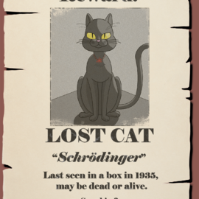

(Very) Basics of Quantum Crypto
Amit Behera
Stanford University June 3, 2025
Slides Courtesy:
Prof. Or Sattath

Slide 2
Why quantum mechanics?
Quantum mechanics: theory best describing microscopic systems
Why the need of a separate theory?
Can’t this be abstracted away?
No. Quantum mechanics fundamentally changes the notions of information and computation.

Slide 3
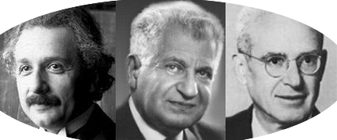
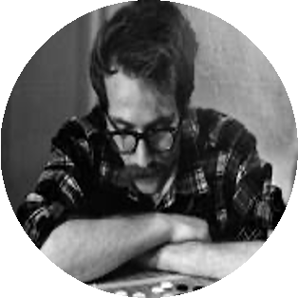
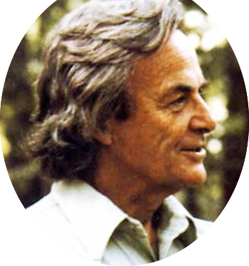
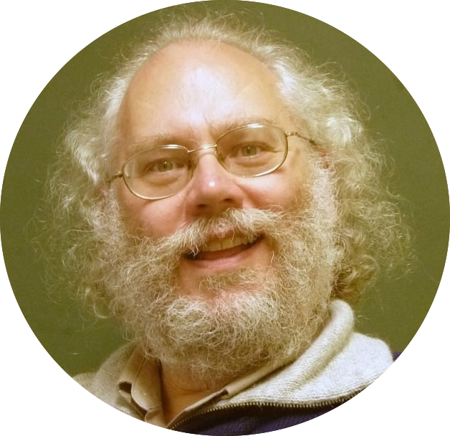
How did it all start?
40-60’s: Quantum mechanics is hard to simulate on a classical computer
70’s: Unknown quantum states are hard to clone. We can build unforgeable money using them.
80’s: If it’s hard to simulate, we can use it to build a quantum computer, which (might) have more power than a classical computer.
90’s: Yes! Quantum computers can solve certain computational problems (such as Factoring) efficiently, for which there is no (existing) classical efficient algorithm.

Slide 4
What are qubits?

Slide 5
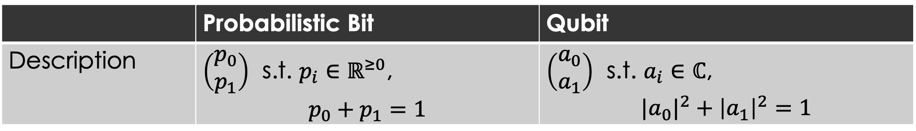
Probabilistic Bit vs. Qubit
 | Probabilistic Bit | Qubit
Description | $\left(\begin{matrix}p_{0} \\ p_{1}\end{matrix}\right)$ s.t. $p_{i}∈ℝ^{≥0}$, $$p_{0}+p_{1}=1$$ | $\left(\begin{matrix}a_{0} \\ a_{1}\end{matrix}\right)$ s.t. $a_{i}∈ℂ$, $${|a}_{0}|^{2}+{\left|a_{1}\right|}^{2}=1$$
Notes:
5 minutes to here.

Slide 6
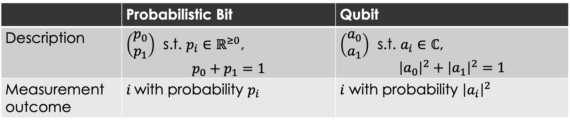
Probabilistic Bit vs. Qubit
 | Probabilistic Bit | Qubit
Description | $\left(\begin{matrix}p_{0} \\ p_{1}\end{matrix}\right)$ s.t. $p_{i}∈ℝ^{≥0}$, $$p_{0}+p_{1}=1$$ | $\left(\begin{matrix}a_{0} \\ a_{1}\end{matrix}\right)$ s.t. $a_{i}∈ℂ$, $${\left|a_{0}\right|}^{2}+{\left|a_{1}\right|}^{2}=1$$
Measurement outcome | $i$with probability $p_{i}$ | $i$ with probability ${\left|a_{i}\right|}^{2}$
Notes:
5 minutes to here.

Slide 7
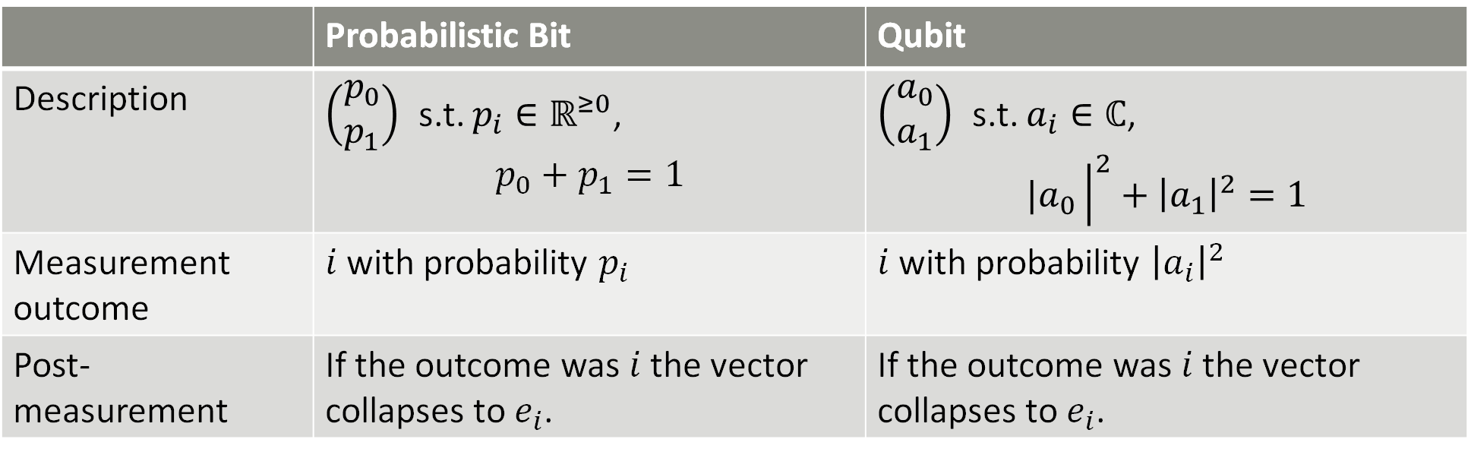
Probabilistic Bit vs. Qubit
 | Probabilistic Bit | Qubit
Description | $\left(\begin{matrix}p_{0} \\ p_{1}\end{matrix}\right)$ s.t. $p_{i}∈ℝ^{≥0}$, $$p_{0}+p_{1}=1$$ | $\left(\begin{matrix}a_{0} \\ a_{1}\end{matrix}\right)$ s.t. $a_{i}∈ℂ$, $${|a}_{0}{\left.​\right|}^{2}+{\left|a_{1}\right|}^{2}=1$$
Measurement outcome | $i$with probability $p_{i}$ | $i$ with probability ${\left|a_{i}\right|}^{2}$
Post-measurement | If the outcome was $i$ the vector collapses to $e_{i}$. | If the outcome was $i$ the vector collapses to $e_{i}$.
Notes:
5 minutes to here.

Slide 8
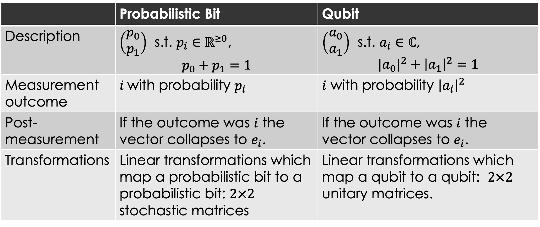
Probabilistic Bit vs. Qubit
 | Probabilistic Bit | Qubit
Description | $\left(\begin{matrix}p_{0} \\ p_{1}\end{matrix}\right)$ s.t. $p_{i}∈ℝ^{≥0}$, $$p_{0}+p_{1}=1$$ | $\left(\begin{matrix}a_{0} \\ a_{1}\end{matrix}\right)$ s.t. $a_{i}∈ℂ$, $${|a}_{0}|^{2}+{\left|a_{1}\right|}^{2}=1$$
Measurement outcome | $i$with probability $p_{i}$ | $i$ with probability ${\left|a_{i}\right|}^{2}$
Post-measurement | If the outcome was $i$ the vector collapses to $e_{i}$. | If the outcome was $i$ the vector collapses to $e_{i}$.
Transformations | Linear transformations which map a probabilistic bit to a probabilistic bit: $2×2$ stochastic matrices | Linear transformations which map a qubit to a qubit: $2×2$ unitary matrices.
Notes:
5 minutes to here.

Slide 9
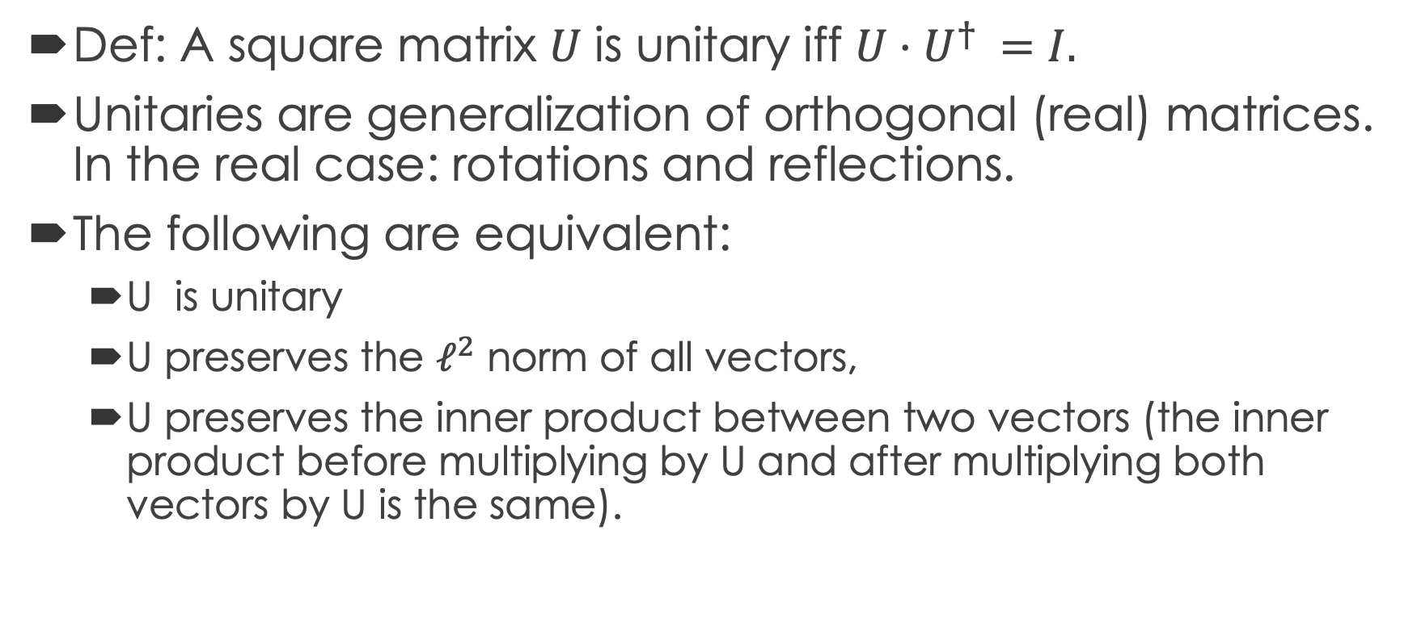
Unitary matrices
Conjugate Transpose
Def: A square matrix 𝑈 is unitary iff $U⋅U^{† }=I.$
Unitaries are generalization of orthogonal (real) matrices. In the real case: rotations and reflections.
The following are equivalent:
  U is unitary
  U preserves the $ℓ^{2}$ norm of all vectors,
  U preserves the inner product between two vectors (the inner product before multiplying by U and after multiplying both vectors by U is the same).

Slide 10
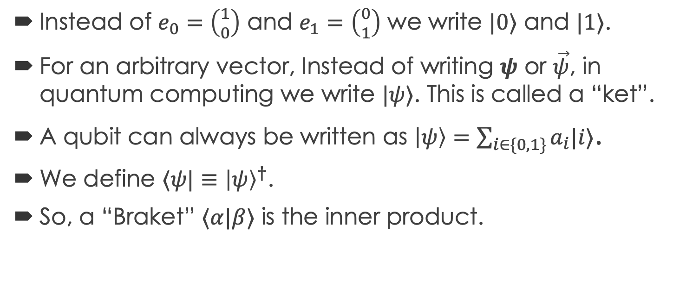
Dirac’s notation
Instead of $e_{0}=\left({1 \atop 0}\right)$ and $e_{1}=\left({0 \atop 1}\right)$ we write $|0⟩$ and $|1⟩$.
For an arbitrary vector, Instead of writing $ψ$ or $\vec{ψ}$, in quantum computing we write $|ψ⟩$. This is called a “ket”.
A qubit can always be written as $\left|ψ\right\rangle =\sum_{i∈\{0,1\}}{a_{i}|i⟩}$.
We define $⟨ψ|≡{\left|ψ\right\rangle }^{†}$.
So, a “Braket” $⟨α|β⟩$ is the inner product.

Slide 11

Important states and unitaries
$|+⟩≡\frac{1}{\sqrt{2}}(|0⟩+|1⟩ )$, $\left|−\right\rangle ≡\frac{1}{\sqrt{2}}(|0⟩−|1⟩ )$
$H=\frac{1}{√2}\left(\begin{matrix}1 & 1 \\ 1 & −1\end{matrix}\right), H\left|0\right\rangle =\left|+\right\rangle ,H\left|1\right\rangle =|−⟩$.
$R_{θ}=\left(\begin{matrix}\cos{θ} & −\sin{θ} \\ \sin{θ} & \cos{θ}\end{matrix}\right), R_{π/4}\left|0\right\rangle =\left|+\right\rangle ,R_{π/4}\left|+\right\rangle =1$
Notes:
12 minutes to here.

Slide 12
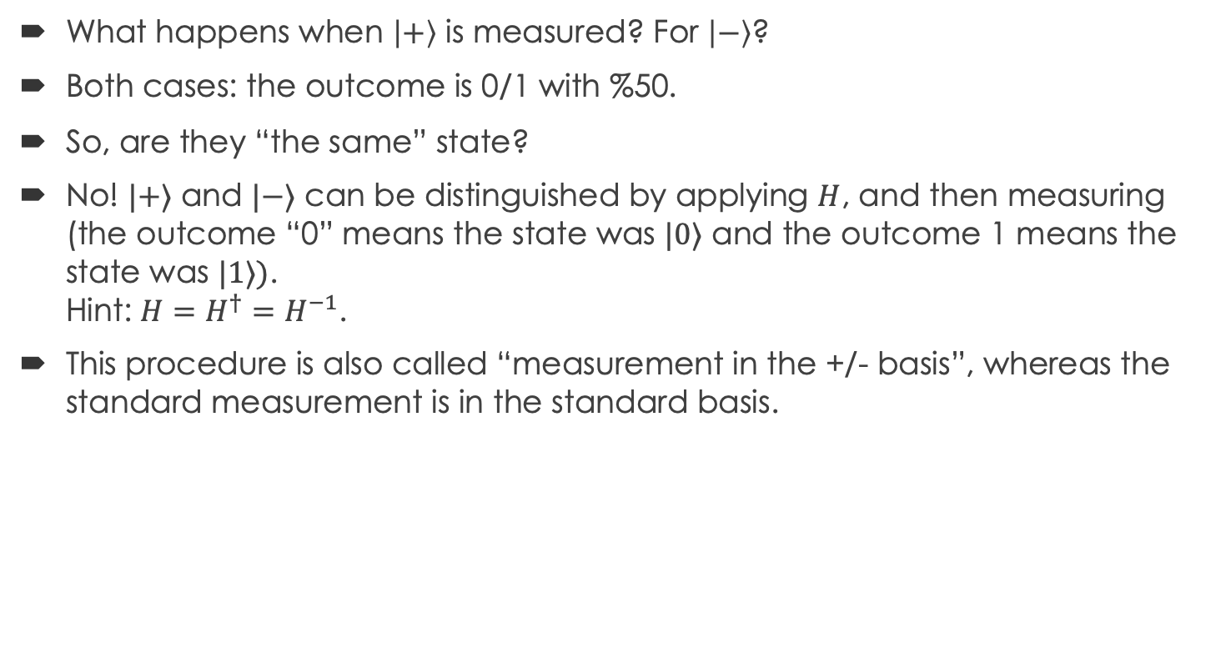
Toy examples:
What happens when $\left|+\right\rangle$ is measured? For $\left|−\right\rangle$?
Both cases: the outcome is 0/1 with %50.
So, are they “the same” state?
No! $|+⟩$ and $|−⟩$ can be distinguished by applying $H$, and then measuring (the outcome “0” means the state was $|0⟩$ and the outcome 1 means the state was $|1⟩)$.
Hint: $H=H^{†}=H^{−1}$.
This procedure is also called “measurement in the +/- basis”, whereas the standard measurement is in the standard basis.

Slide 13

Measurements in another basis
Measuring the state $\left|ψ\right\rangle = \sum_{i∈\{0,1\}}{a_{i}}|i⟩$ yields the outcome $i$ with probability ${|a}_{i}{\left.​\right|}^{2}={\left|\left\langle ψ | i\right\rangle \right|}^{2}.$ We call this a measurement in the standard basis.
We can measure in any orthonormal basis ${\left\{|α_{i}⟩\right\}}_{i}$.
The measurement outcome is $i$ with probability ${\left|\left\langle ψ | α_{i}\right\rangle \right|}^{2}$.

Slide 14
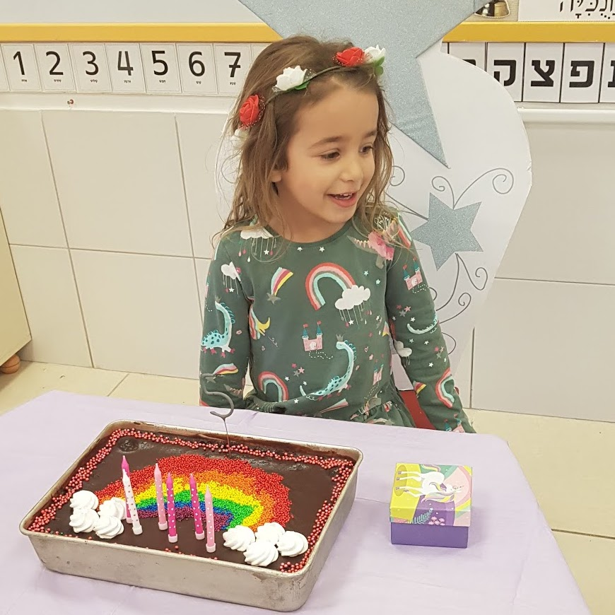
Amalya’s Birthday

Slide 15
Ice fountain candles

Slide 16
The Challenge
Find an ice fountain candle, which would work for sure

Slide 17
Model: dud vs working ice fountain
Dud / Faulty:
Working:

Slide 18
Algorithm [Elitzur-Vaidman’93]:
Identification of a working ice fountain

Slide 19
The dud case

Slide 20
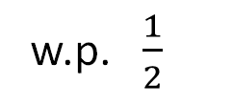

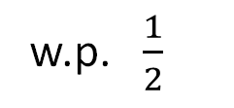
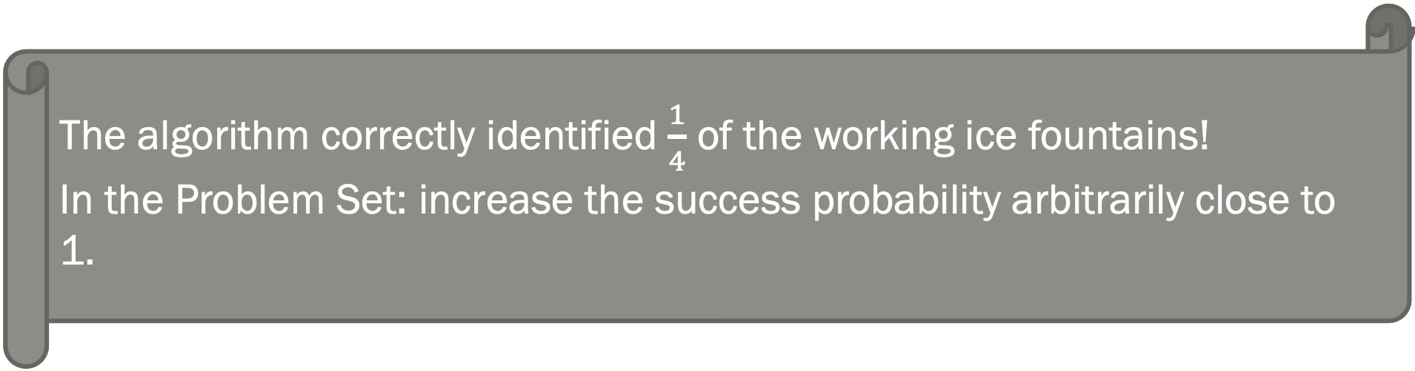
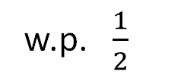
The working case
w.p. $\frac{1}{2}$
The algorithm correctly identified $\frac{1}{4}$ of the working ice fountains!
In the Problem Set: increase the success probability arbitrarily close to 1.
w.p. $\frac{1}{2}$
w.p. $\frac{1}{2}$
w.p. $\frac{1}{2}$

Slide 21
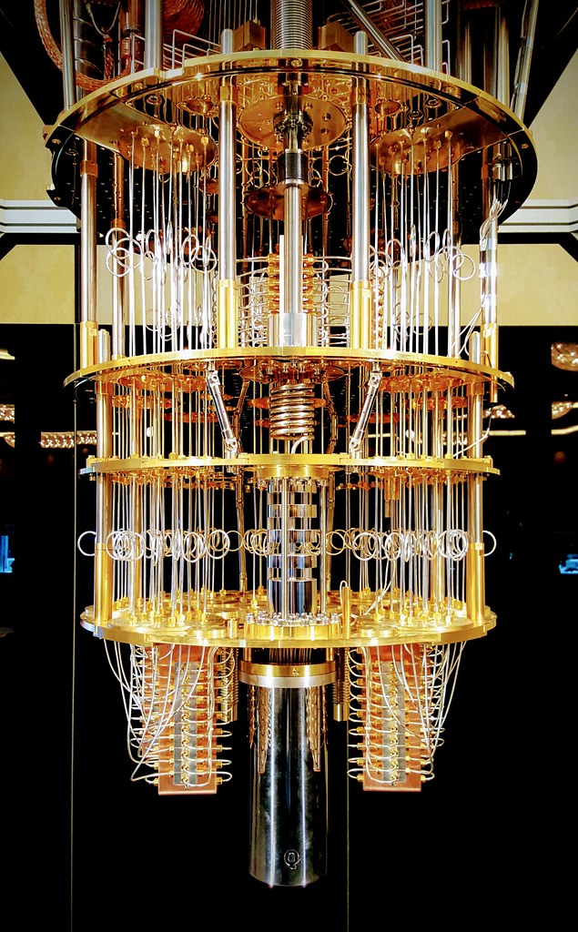
Role of Quantum algorithms in Cryptography
Post-Quantum Cryptography
Build quantum secure crypto primitives
Break Cryptosystems
Shor’s Algorithm for Discrete log and factoring.
Simon’s algorithm breaks Even-Mansour Cipher.
Make new Cryptography
Classically not possible.
Unforgeable money, protection against piracy
Quantum Cryptography
Build inherently quantum crypto primitives

Slide 22
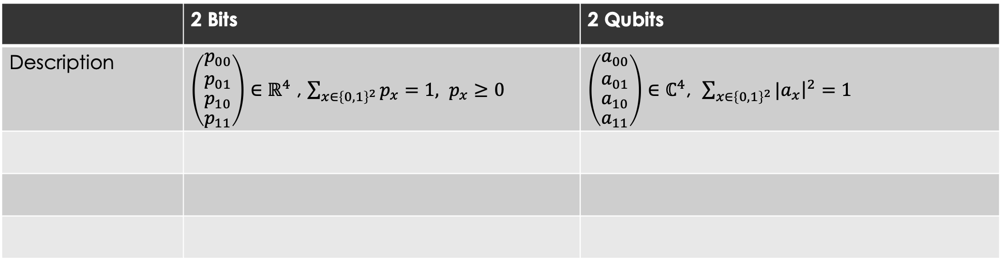
2 Probabilistic Bits vs. 2 Qubits
 | 2 Bits | 2 Qubits
Description | $\left(\begin{aligned}\begin{aligned}\begin{matrix}p_{00} \\ p_{01}\end{matrix} \\ p_{10}\end{aligned} \\ p_{11}\end{aligned}\right)∈ℝ^{4}$ , $\sum_{x∈{\left\{0,1\right\}}^{2}}{p_{x}}=1, p_{x}≥0$ | $\left(\begin{aligned}\begin{aligned}\begin{matrix}a_{00} \\ a_{01}\end{matrix} \\ a_{10}\end{aligned} \\ a_{11}\end{aligned}\right)∈ℂ^{4}$, $\sum_{x∈{\left\{0,1\right\}}^{2}}{{|a}_{x}{\left.​\right|}^{2}}=1$

Slide 23
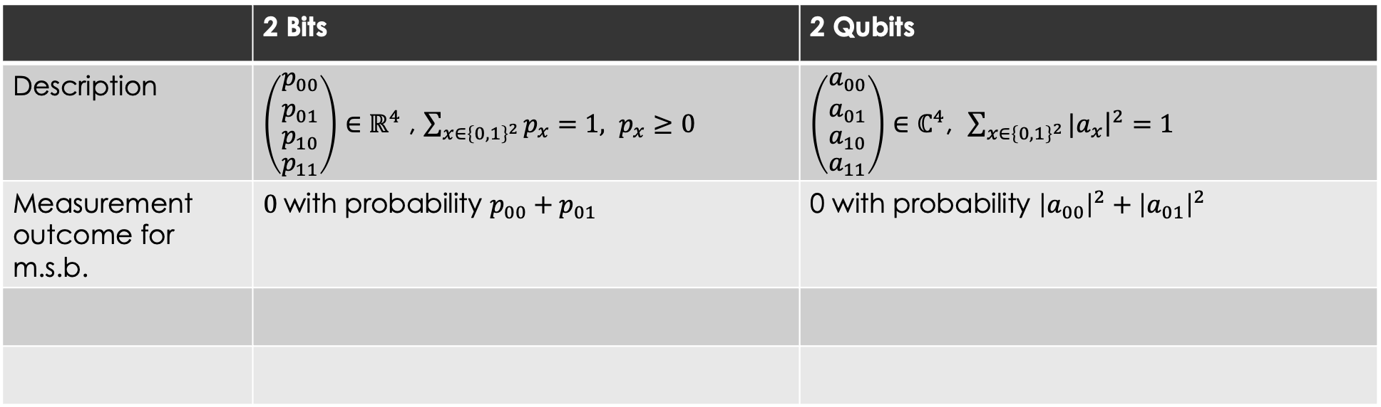
2 Probabilistic Bits vs. 2 Qubits
 | 2 Bits | 2 Qubits
Description | $\left(\begin{aligned}\begin{aligned}\begin{matrix}p_{00} \\ p_{01}\end{matrix} \\ p_{10}\end{aligned} \\ p_{11}\end{aligned}\right)∈ℝ^{4}$ , $\sum_{x∈{\left\{0,1\right\}}^{2}}{p_{x}}=1, p_{x}≥0$ | $\left(\begin{aligned}\begin{aligned}\begin{matrix}a_{00} \\ a_{01}\end{matrix} \\ a_{10}\end{aligned} \\ a_{11}\end{aligned}\right)∈ℂ^{4}$, $\sum_{x∈{\left\{0,1\right\}}^{2}}{{|a}_{x}{\left.​\right|}^{2}}=1$
Measurement outcome for m.s.b. | $0$with probability $p_{00}+p_{01}$ | 0 with probability ${\left|a_{00}\right|}^{2}+{\left|a_{01}\right|}^{2}$

Slide 24
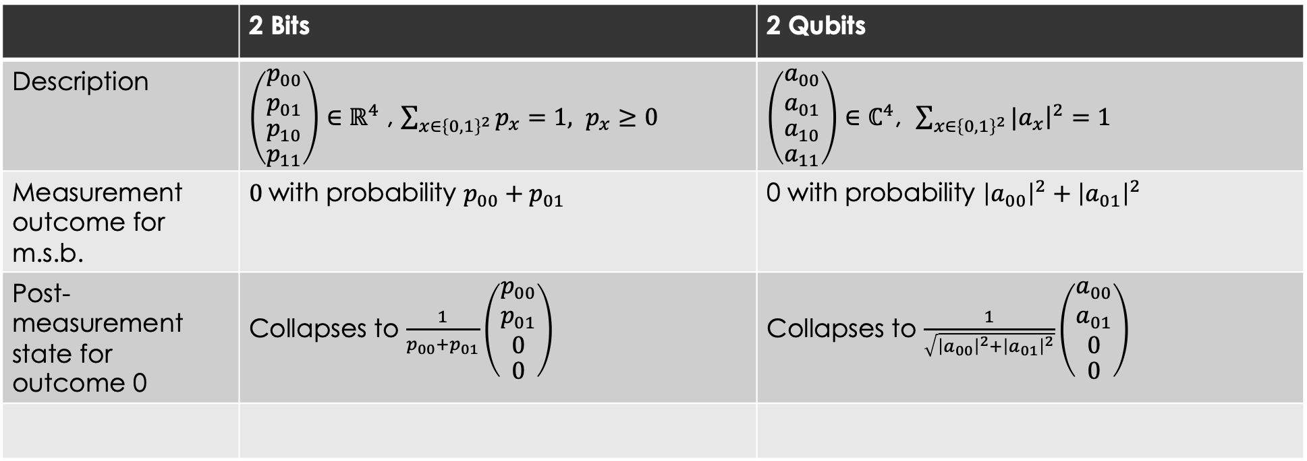
2 Probabilistic Bits vs. 2 Qubits
 | 2 Bits | 2 Qubits
Description | $\left(\begin{aligned}\begin{aligned}\begin{matrix}p_{00} \\ p_{01}\end{matrix} \\ p_{10}\end{aligned} \\ p_{11}\end{aligned}\right)∈ℝ^{4}$ , $\sum_{x∈{\left\{0,1\right\}}^{2}}{p_{x}}=1, p_{x}≥0$ | $\left(\begin{aligned}\begin{aligned}\begin{matrix}a_{00} \\ a_{01}\end{matrix} \\ a_{10}\end{aligned} \\ a_{11}\end{aligned}\right)∈ℂ^{4}$, $\sum_{x∈{\left\{0,1\right\}}^{2}}{{|a}_{x}{\left.​\right|}^{2}}=1$
Measurement outcome for m.s.b. | $0$with probability $p_{00}+p_{01}$ | 0 with probability ${\left|a_{00}\right|}^{2}+{\left|a_{01}\right|}^{2}$
Post-measurement state for outcome 0 | Collapses to $\frac{1}{p_{00}+p_{01}}\left(\begin{aligned}\begin{aligned}\begin{matrix}p_{00} \\ p_{01}\end{matrix} \\ 0\end{aligned} \\ 0\end{aligned}\right)$ | Collapses to $\frac{1}{\sqrt{{\left|a_{00}\right|}^{2}+{\left|a_{01}\right|}^{2}}}\left(\begin{aligned}\begin{aligned}\begin{matrix}a_{00} \\ a_{01}\end{matrix} \\ 0\end{aligned} \\ 0\end{aligned}\right)$

Slide 25
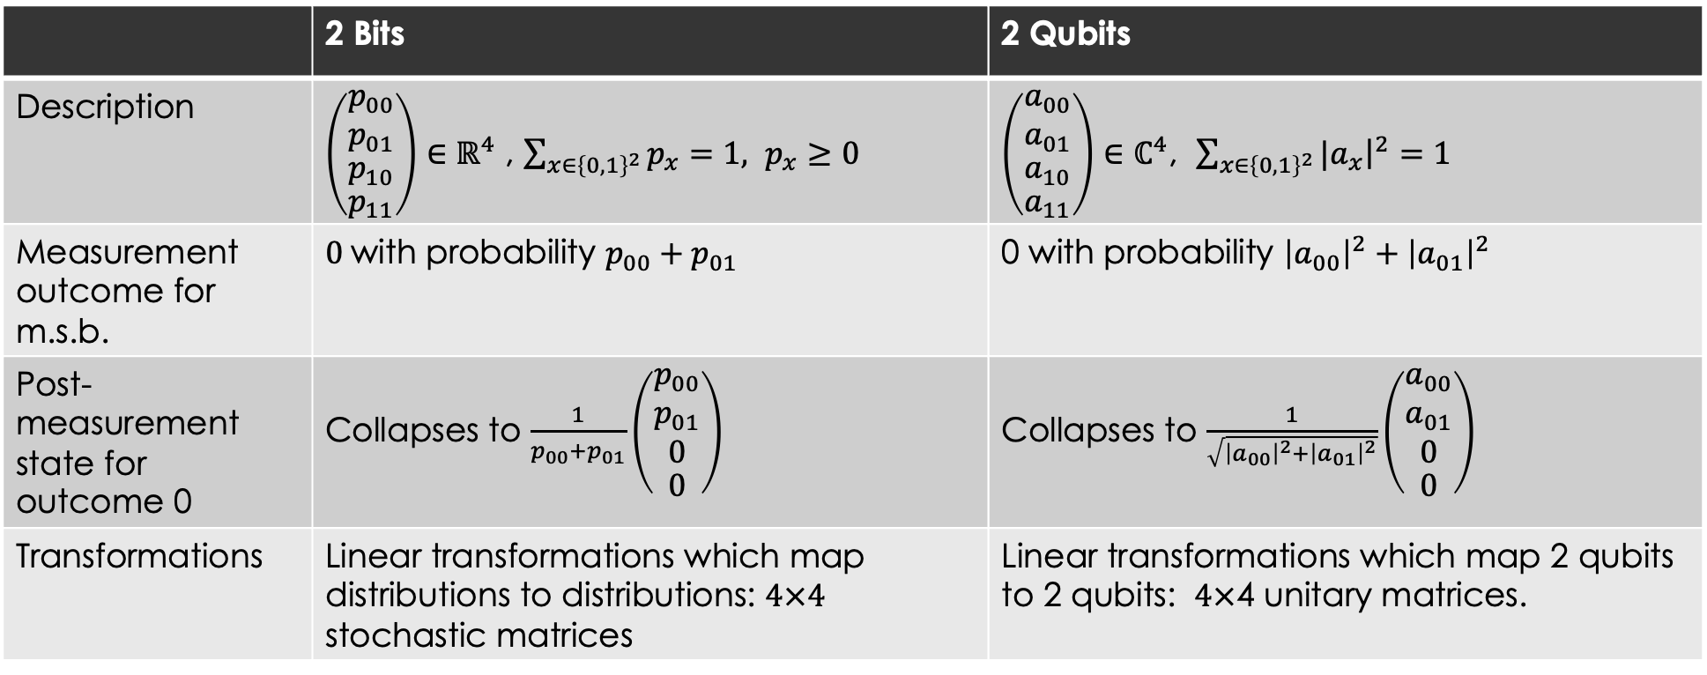
2 Probabilistic Bits vs. 2 Qubits
 | 2 Bits | 2 Qubits
Description | $\left(\begin{aligned}\begin{aligned}\begin{matrix}p_{00} \\ p_{01}\end{matrix} \\ p_{10}\end{aligned} \\ p_{11}\end{aligned}\right)∈ℝ^{4}$ , $\sum_{x∈{\left\{0,1\right\}}^{2}}{p_{x}}=1, p_{x}≥0$ | $\left(\begin{aligned}\begin{aligned}\begin{matrix}a_{00} \\ a_{01}\end{matrix} \\ a_{10}\end{aligned} \\ a_{11}\end{aligned}\right)∈ℂ^{4}$, $\sum_{x∈{\left\{0,1\right\}}^{2}}{{|a}_{x}{\left.​\right|}^{2}}=1$
Measurement outcome for m.s.b. | $0$with probability $p_{00}+p_{01}$ | 0 with probability ${\left|a_{00}\right|}^{2}+{\left|a_{01}\right|}^{2}$
Post-measurement state for outcome 0 | Collapses to $\frac{1}{p_{00}+p_{01}}\left(\begin{aligned}\begin{aligned}\begin{matrix}p_{00} \\ p_{01}\end{matrix} \\ 0\end{aligned} \\ 0\end{aligned}\right)$ | Collapses to $\frac{1}{\sqrt{{\left|a_{00}\right|}^{2}+{\left|a_{01}\right|}^{2}}}\left(\begin{aligned}\begin{aligned}\begin{matrix}a_{00} \\ a_{01}\end{matrix} \\ 0\end{aligned} \\ 0\end{aligned}\right)$
Transformations | Linear transformations which map distributions to distributions: $4×4$ stochastic matrices | Linear transformations which map 2 qubits to 2 qubits: $4×$4 unitary matrices.

Slide 26

Multiple qubits via tensor products
Instead of thinking of 2 qubits as a vector in $ℂ^{4}$, we can think of them as vectors in $ℂ^{2}⊗ℂ^{2}$.
$\{\left|0\right\rangle ⊗\left|0\right\rangle ,\left|0\right\rangle ⊗\left|1\right\rangle ,\left|1\right\rangle ⊗\left|0\right\rangle ,\left|1\right\rangle ⊗\left|1\right\rangle \}$ form the standard basis of $ℂ^{2}⊗ℂ^{2}$.
Can be generalized to higher number of qubits.
Some 2-qubit unitary transformation: CNOT.

Slide 27
No Cloning: Quantum states are difficult to copy
Classical bit strings can be generically read and copied.
No way to generically copy unknown quantum states.
  We can copy if the basis is known.
Notes:
If there exists a unitary transformation that copies |0>, |1>, then by linearity it does not copy |+>.

Slide 28


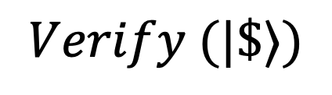



Unforgeable Money scheme
$$\$_{1}$$
$$\$_{2}$$
$$\$_{3}$$
$$Verify (|\$⟩)$$

Slide 29
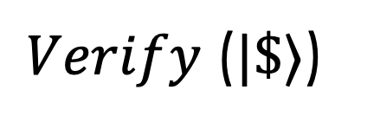



Unforgeable Money scheme
$$|\$_{1}⟩$$
$$|\$_{2}⟩$$
$$|\$_{3}⟩$$
$Verify$($|\$⟩$)

Slide 30





Unforgeable Money scheme
$$\$’$$
$$\$$$
$$Verify$$
$$\$’’$$
Classically any money state can be cloned to forge!
Using Quantum states as money states?
  No -cloning.

Slide 31

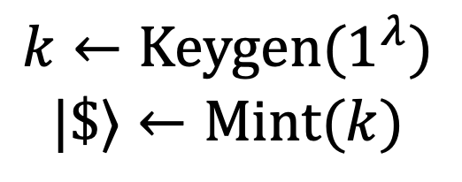
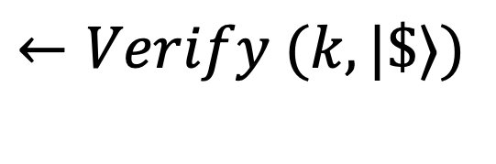
Private Quantum Money scheme
(Keygen, Mint, Verify)
$$|\$⟩$$
$$k←Keygen(1^{λ})$$
$$|\$⟩←Mint(k)$$
Bank’s secret
$$←Verify (k,|\$⟩)$$

Slide 32

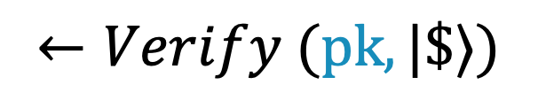
(Public) Quantum Money scheme
(Keygen, Mint, Verify)
pk
$$|\$⟩$$
Stronger and more usable
Harder to construct
pk,
$$k←Keygen(1^{λ})$$
$$|\$⟩←Mint(k)$$
$$←Verify (pk,|\$⟩)$$

Slide 33
Focus: Private Quantum Money scheme
(Keygen, Mint, Verify)
$$|\$⟩$$
$$k←Keygen(1^{λ})$$
$$|\$⟩←Mint(k)$$
$$←Verify (k,|\$⟩)$$

Slide 34
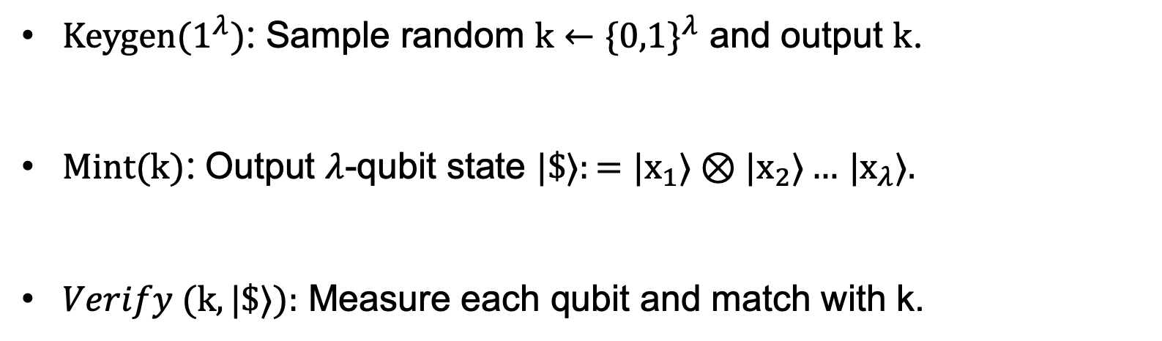
Warmup Private Quantum Money construction
(Keygen, Mint, Verify)
$Keygen(1^{λ})$: Sample random $k←\{0,1\}^{λ}$ and output $k$.
$Mint(k)$: Output $λ$-qubit state $|\$⟩:=|x_{1}⟩⊗|x_{2}⟩…$ $|x_{λ}⟩.$
$Verify (k,|\$⟩):$ Measure each qubit and match with k.
Classical Scheme
Is it secure?
Can measure to copy.

Slide 35
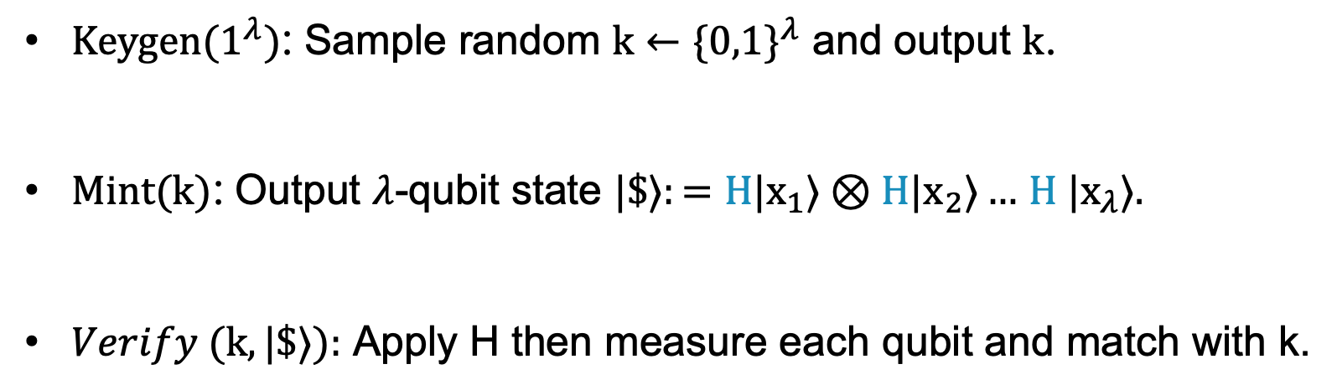
Warmup Private Quantum Money construction
(Keygen, Mint, Verify)
$Keygen(1^{λ})$: Sample random $k←\{0,1\}^{λ}$ and output $k$.
$Mint(k)$: Output $λ$-qubit state $|\$⟩:=H|x_{1}⟩⊗H|x_{2}⟩…$ $H |x_{λ}⟩.$
$Verify (k,|\$⟩):$ Apply H then measure each qubit and match with k.
Is it secure?
Invert H and measure to copy.

Slide 36
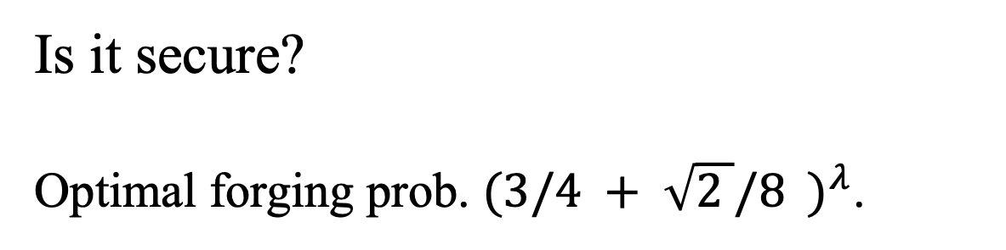
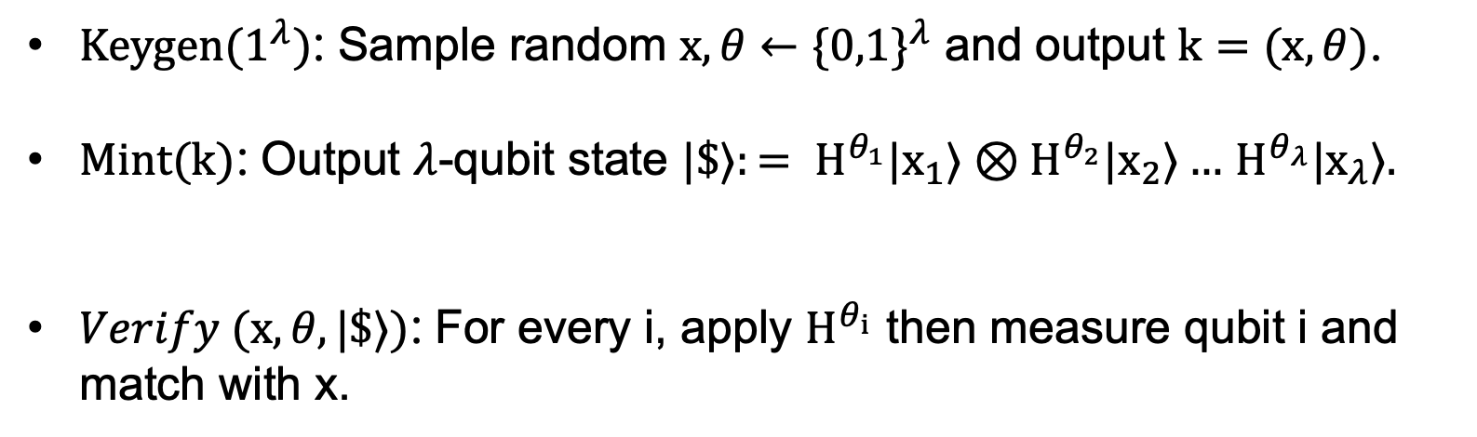
Wiesner’s Private Quantum Money construction’83
(Keygen, Mint, Verify)
$Keygen(1^{λ})$: Sample random $x,θ←\{0,1\}^{λ}$ and output $k=(x,θ)$.
$Mint(k)$: Output $λ$-qubit state ${|\$⟩:= H}^{θ_{1}}|x_{1}⟩⊗H^{θ_{2}}|x_{2}⟩…$ $H^{θ_{λ}}|x_{λ}⟩.$
$Verify (x,θ,|\$⟩)$: For every i, apply $H^{θ_{i}}$ then measure qubit i and match with x.
Is it secure?
Optimal forging prob. ${(3/4 + \sqrt{2 }/8 )}^{λ}$.
Molina-Vidick-Watrous’12.
Also see Pastawski et al. 11

Slide 37
Quantum Cryptography landscape from an unclonable lens
Unclonable Cryptography
Based on No-cloning
Quantum Copy-protection
Public Quantum Money
Known how to construct based on iO.
One-time signing tokens
Secure key leasing
Quantum Lightning
One-shot signatures
Notes:
Next moving forward from money we can try to add functionality to the quantum state, so instead of thinking the unclonable state as a money state think of it as a token that lets you sign messages but only once as it self destructs after that. Next we can extend this to study this kind of revocabality for other functionalities such as decryption etc, where we want to revoke access to the functionality later, which is captured in secure software leasing. Finally, in terms of functionality we can think of arbitrary programs or softwares and issue quantum programs that lets you evaluate the state but you cannot make two working copies of the program that you can pirate, which is what we cover in quantum copy-protection.

Slide 38
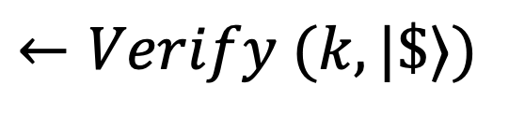
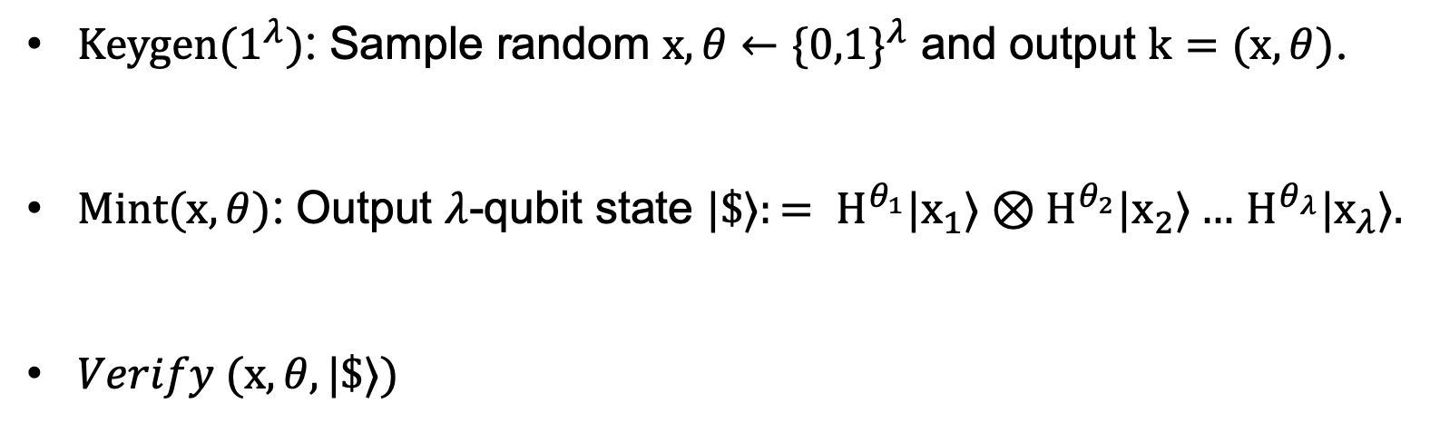
Wiesner’s Private Quantum Money scheme
(Keygen, Mint, Verify)
$Keygen(1^{λ})$: Sample random $x,θ←\{0,1\}^{λ}$ and output $k=(x,θ)$.
$Mint(x,θ)$: Output $λ$-qubit state ${|\$⟩:= H}^{θ_{1}}|x_{1}⟩⊗H^{θ_{2}}|x_{2}⟩…$ $H^{θ_{λ}}|x_{λ}⟩.$
$Verify (x,θ,|\$⟩)$
$$k←Keygen(1^{λ})$$
$$|\$⟩←Mint(k)$$
$$←Verify (k,|\$⟩)$$

Slide 39
Wiesner’s Private Quantum Money scheme
(Keygen, Mint, Verify)
$Keygen(1^{λ})$: Sample random $x,θ←\{0,1\}^{λ}$ and output $k=(x,θ)$.
$Mint(x,θ)$: Output $λ$-qubit state ${|\$⟩:= H}^{θ_{1}}|x_{1}⟩⊗H^{θ_{2}}|x_{2}⟩…$ $H^{θ_{λ}}|x_{λ}⟩.$
$Verify (x,θ,|\$⟩)$
$$k←Keygen(1^{λ})$$
$$|\$⟩←Mint(k)$$
$$←Verify (k,|\$⟩)$$

Slide 40
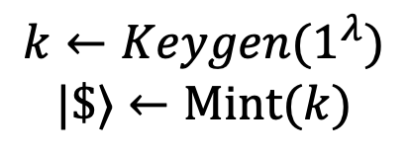
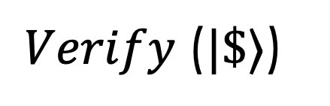
Types of verification for money
pk
$$\$$$
$$k←Keygen(1^{λ})$$
$$|\$⟩←Mint(k)$$
$Verify$($|\$⟩$)

Slide 41
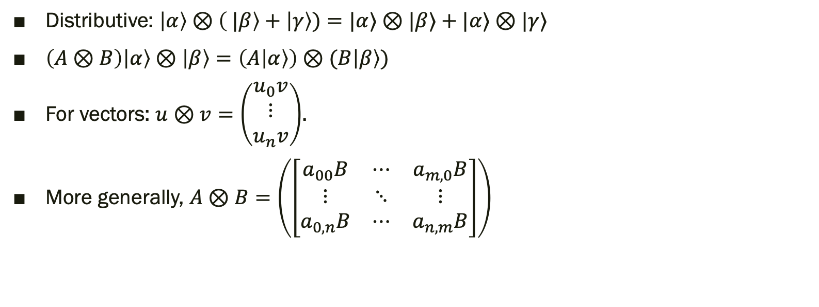
Cheat-sheet for tensor products
Distributive: $\left|α\right\rangle ⊗\left( |β\right\rangle +\left|γ\right\rangle )=|α⟩⊗|β⟩+|α⟩⊗|γ⟩$
$\left(A⊗B\right)\left|α\right\rangle ⊗\left|β\right\rangle =\left(A\left|α\right\rangle \right)⊗(B\left|β\right\rangle )$
For vectors: $u⊗v=\left(\begin{matrix}u_{0}v \\ ⋮ \\ u_{n}v\end{matrix}\right)$.
More generally, $A⊗B=\left(\left[\begin{matrix}a_{00}B & ⋯ & a_{m,0}B \\ ⋮ & ⋱ & ⋮ \\ a_{0,n}B & ⋯ & a_{n,m}B\end{matrix}\right]\right)$

Slide 42
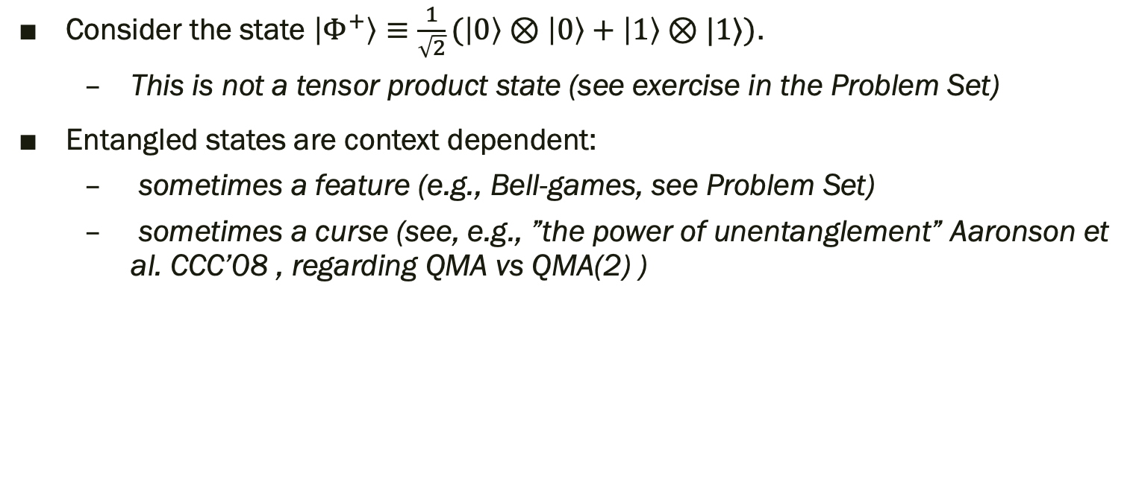
Entangled states
Consider the state $\left|Φ^{+}\right\rangle ≡\frac{1}{\sqrt{2}}(\left|0\right\rangle ⊗\left|0\right\rangle +\left|1\right\rangle ⊗|1⟩)$.
  This is not a tensor product state (see exercise in the Problem Set)
Entangled states are context dependent:
  sometimes a feature (e.g., Bell-games, see Problem Set)
  sometimes a curse (see, e.g., ”the power of unentanglement” Aaronson et al. CCC’08 , regarding QMA vs QMA(2) )

Slide 43
Gates
Classical Gates
Quantum Gates
Gates are local operations that act on at most 3 bits.
A gate has 3 input wires and output wires.
Example: “AND” gate
Gates are local operations acting on at most 3 qubits
A gate is a unitary acting on 3 qubits (3 input and output wires)
Example: “CNOT” gate

Slide 44
Circuits
Classical Circuit
Quantum Gates
Combines multiple (classical) gates
Combines multiple (quantum) gates, and measurements.
Output
Measurement
Input
Complexity measures: circuit size (3 & 6), and depth (2 & 3)

Slide 45
Computational Problems
Computational problems are well-defined Yes/No questions.
  Given a number, is it prime?
    11-Prime! 15-not prime!
  Given a graph, is it Eulerian? (Is there a path that visits each edge exactly once?)
Language: The set of “yes” answers.
  PRIMES={2, 3, 5, 7, 11, 13, 17, 19,…}

Slide 46
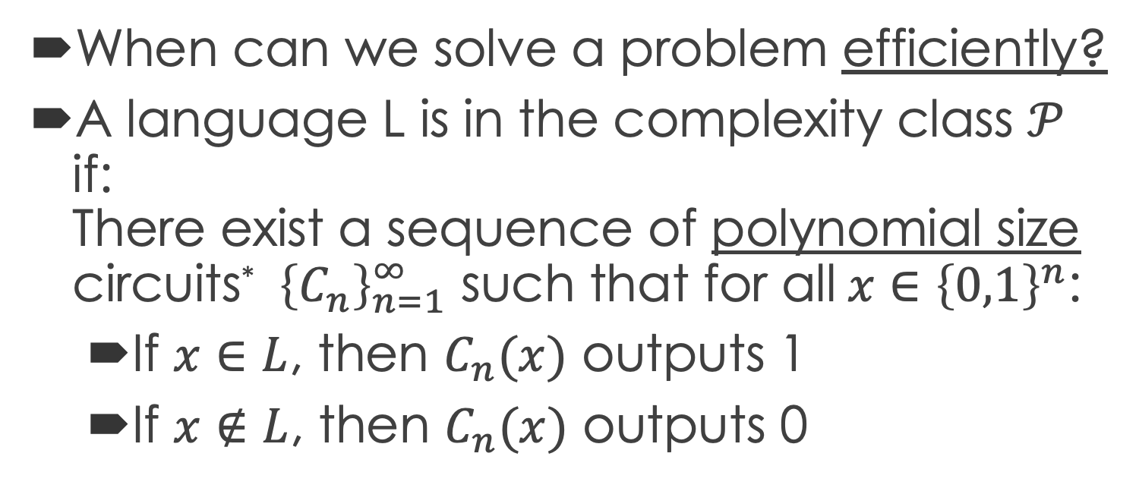
Efficient Classical Computation
When can we solve a problem efficiently?
A language L is in the complexity class $𝒫$ if:
There exist a sequence of polynomial size circuits* ${\left\{C_{n}\right\}}_{n=1}^{∞}$ such that for all$x∈{\left\{0,1\right\}}^{n}$:
  If $x∈L$, then $C_{n}(x)$ outputs 1
  If $x∉L$, then $C_{n}(x)$ outputs 0

Slide 47
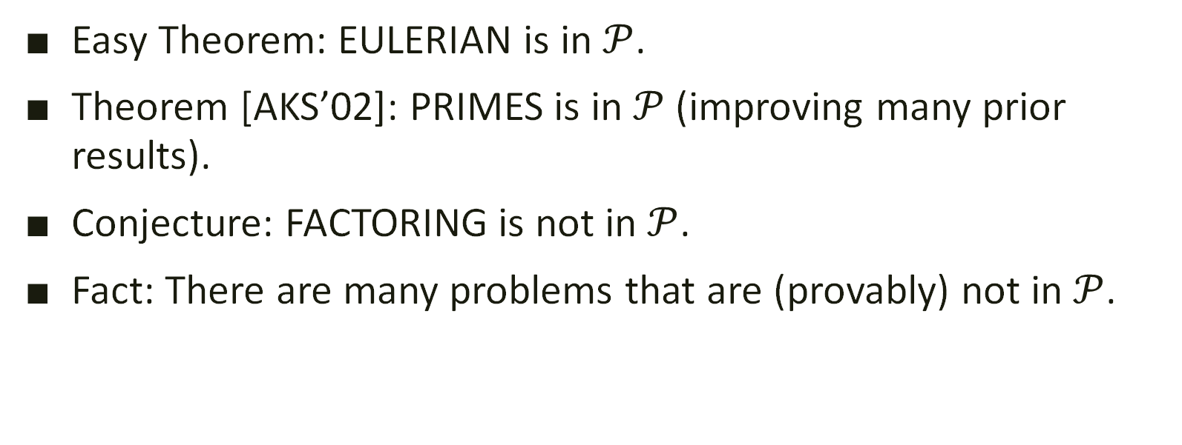
Efficient Classical Computation (contd.)
Easy Theorem: EULERIAN is in $𝒫$.
Theorem [AKS’02]: PRIMES is in $𝒫$ (improving many prior results).
Conjecture: FACTORING is not in $𝒫$.
Fact: There are many problems that are (provably) not in $𝒫$.

Slide 48
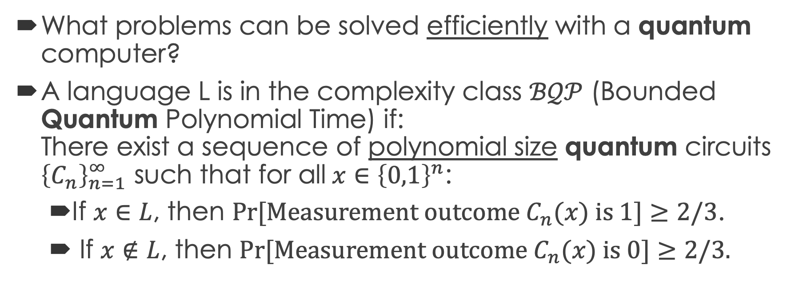
Efficient Quantum Computation
What problems can be solved efficiently with a quantum computer?
A language L is in the complexity class $ℬ𝒬𝒫$ (Bounded Quantum Polynomial Time) if:
There exist a sequence of polynomial size quantum circuits ${\left\{C_{n}\right\}}_{n=1}^{∞}$ such that for all$x∈{\left\{0,1\right\}}^{n}$:
  If $x∈L$, then $Pr[Measurement outcome C_{n}(x) is 1]≥2/3$.
  If $x∉L$, then $Pr[Measurement outcome C_{n}(x) is 0]≥2/3.$

Slide 49
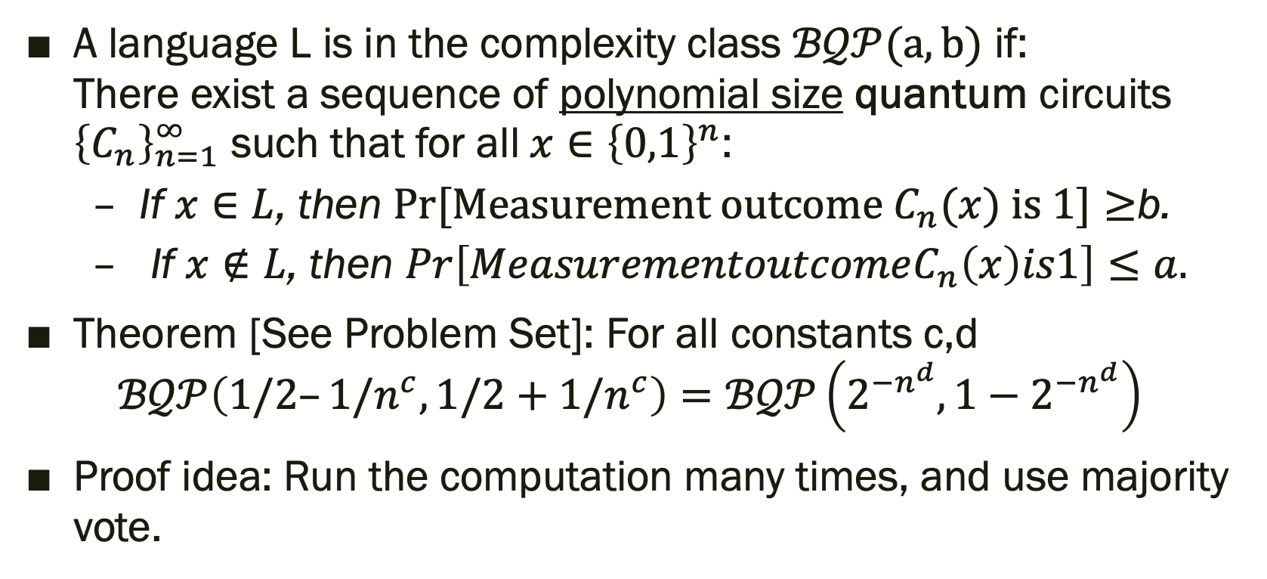
Amplification
A language L is in the complexity class $ℬ𝒬𝒫(a,b)$ if:
There exist a sequence of polynomial size quantum circuits ${\left\{C_{n}\right\}}_{n=1}^{∞}$ such that for all$x∈{\left\{0,1\right\}}^{n}$:
  If $x∈L$, then $Pr[Measurement outcome C_{n}(x) is 1]≥$b.
  If $x∉L$, then $Pr\left[MeasurementoutcomeC_{n}\left(x\right)is1\right]≤a.$
Theorem [See Problem Set]: For all constants c,d
$ℬ𝒬𝒫\left(1/2–1/n^{c},1/2+1/n^{c}\right)=ℬ𝒬𝒫\left(2^{−n^{d}},1−2^{−n^{d}}\right)$
Proof idea: Run the computation many times, and use majority vote.

Slide 50

$$𝒫⊆ℬ𝒬𝒫$$
Fact: AND and OR gates are universal for classical circuits, i.e., every circuit that can be computed with AND and OR with a small multiplicative gate complexity overhead.
Suppose a function f can be computed via a classical circuit, that uses AND and NOT gates. Then, we can keep the NOT gate (since X is unitary), and replace the AND gates with Toffoli gates (and enough ancilla qubits to “store” the result).

Slide 51
Clean Computation: Motivation
In many cases, we want to compute a function f as a subroutine, inside a quantum circuit.
One goal is to create interference between different branches. The garbage destroys the interference.

Slide 52
Clean Computation: Construction
Instead of:
We clean:

Slide 53

Invertible computation
When can we apply the unitary $|x⟩↦|f(x)⟩$?
If f is invertible, and both direction have efficient circuits, we can:

Slide 54
Thank you!
Questions?

Slide 55
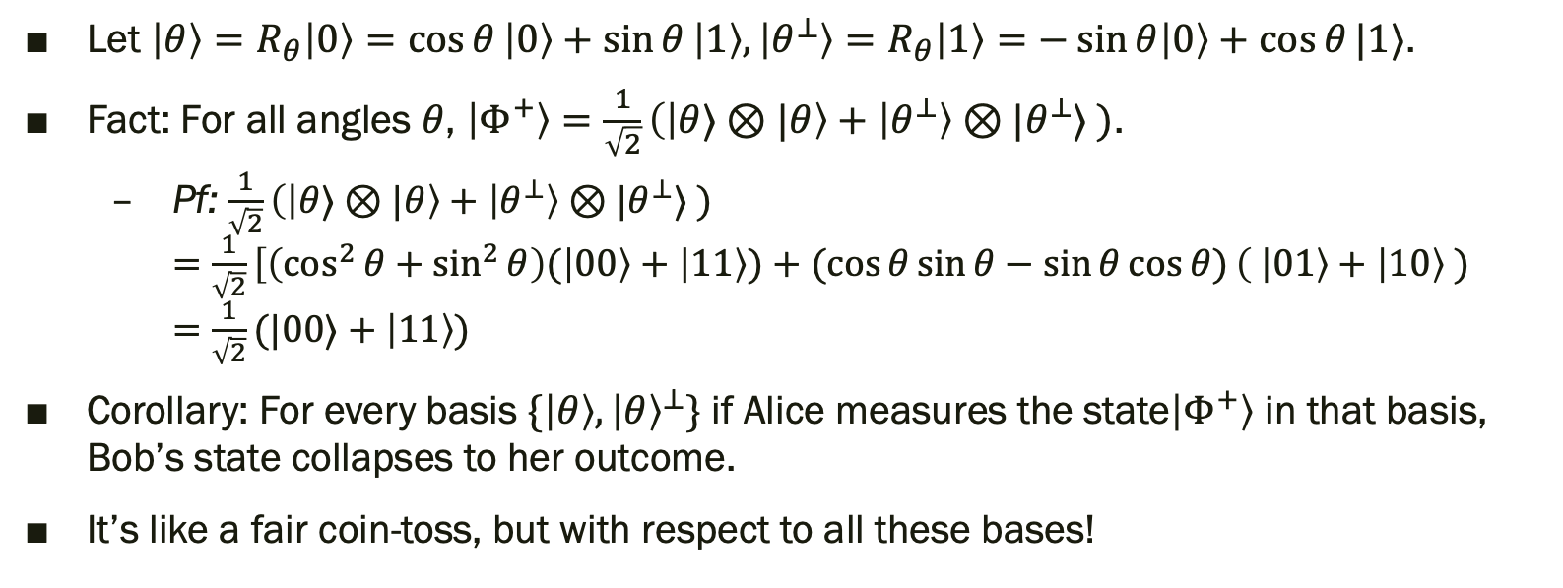
Entangled states
Let $\left|θ\right\rangle =R_{θ}\left|0\right\rangle =\cos{θ}\left|0\right\rangle +\sin{θ}\left|1\right\rangle , \left|θ^{⊥}\right\rangle =R_{θ}\left|1\right\rangle =−\sin{θ\left|0\right\rangle }+\cos{θ}|1⟩$.
Fact: For all angles $θ$, $\left|Φ^{+}\right\rangle =\frac{1}{\sqrt{2}}\left(\left|θ⟩⊗|θ\right\rangle + | θ^{⊥}\right\rangle ⊗|θ^{⊥}⟩ )$.
  Pf: $\frac{1}{\sqrt{2}}\left(\left|θ⟩⊗|θ\right\rangle + | θ^{⊥}\right\rangle ⊗|θ^{⊥}⟩ )$
  $=$ $\frac{1}{\sqrt{2}}\left[\left(\cos^{2}{θ}+\sin^{2}{θ}\right)( | 00\right\rangle +\left|11\right\rangle )+(cos{θ}\sin{θ}−\sin{θ}\cos{θ)}\left( | 01\right\rangle +\left|10\right\rangle )$
  $=$ $\frac{1}{\sqrt{2}}(|00⟩+\left|11\right\rangle )$
Corollary: For every basis $\{\left|θ\right\rangle ,{\left|θ\right\rangle }^{⊥}\}$ if Alice measures the state$\left|Φ^{+}\right\rangle$ in that basis, Bob’s state collapses to her outcome.
It’s like a fair coin-toss, but with respect to all these bases!

Slide 56
Entangled states (II)
Entangled states cannot be used for faster-than-light communication.
  For similar reason as classical correlations
Entanglement can be seen as another type of resource
  Teleportation: 2 bits of classical communication + 1 EPR pair -> communication of 1 qubit.
  Super-dense coding: 1 qubit of communication + 1 EPR pair -> 2 bits of classical communication
  Used in non-local games (next…)
  …

Slide 57



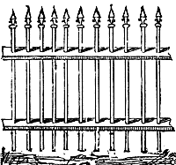

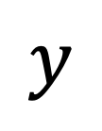
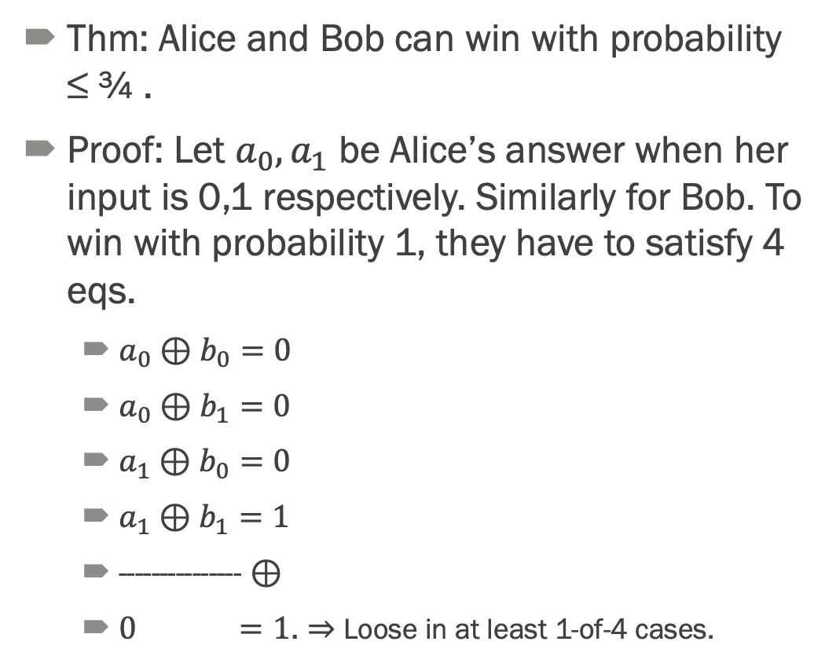




CHSH Game
Shared Randomness doesn’t help: Winning probability is a convex combination of deterministic winning probabilities
Thm: Alice and Bob can win with probability ≤ ¾ .
Proof: Let $a_{0},a_{1}$ be Alice’s answer when her input is 0,1 respectively. Similarly for Bob. To win with probability 1, they have to satisfy 4 eqs.
  $a_{0}⊕b_{0}=0$
  $a_{0}⊕b_{1}=0$
  $a_{1}⊕b_{0}=0$
  $a_{1}⊕b_{1}=1$
  --------------- $⊕$
  $0 =1$. $⇒$ Loose in at least 1-of-4 cases.
$$x$$
$$y$$
$$a$$
$$b$$
They win if: $a⊕b=x∧y$

Slide 58

















CHSH Game
$$\left|Φ^{+}\right\rangle =\frac{1}{\sqrt{2}}\left(\left|θ⟩⊗|θ\right\rangle + | θ^{⊥}\right\rangle ⊗|θ^{⊥}⟩ )$$
Thm: Entanglement help Alice and Bob to win with w.p. $≈80\%>3/4$.
  $x=0,y=0:$ Alice measures in the standard basis. If Alice measures “0”, Bob’s state will collapse to $\left|0\right\rangle$. Bob will also measure 0.
  If Alice measures 1, Bob will measure 1. $⇒$ $\operatorname{Pr}{(a=b)}=1$.
  $x=0,y=1$: If Alice measures “0”, Bob’s state collapses to 0. Bob’s probability to output 0 is $\cos^{2}\left(\frac{π}{8}\right)≈0.85$. Similar if Alice measures “1”.
  $x=1,y=0$: Symmetric. $\operatorname{Pr}{(a=b)}≈0.85$.
  $x=1,y=1$: If Alice measures “0”, Bob’s state collapses to the state she measured. Bob’s basis has 45 degrees, and therefore they win with probability $\frac{1}{2}$.
  Total winning probability: $\frac{1}{4}\left(1+2\cos^{2}\left(\frac{π}{8}\right)+\frac{1}{2}\right)≈0.801$.
Goal: Alice and Bob want to output the same answer, except the case when they are both given x=y=1 (in which case, they should output opposite answers).
$$x$$
$$y$$
$$a$$
$$b$$
Win if: $a⊕b=x∧y$
$$x=0$$
$$y=0$$
$$1$$
$$1$$
$$0$$
$$0$$
$$1$$
$$1$$
$$x=1$$
$$y=1$$
$$0$$
$$0$$

Slide 59
Caveats
What we called here a “state” is actually a “pure state”. There are more general states which are called “mixed states”. A mixed state represent a probability distribution over pure states. You’ll hear about them in the next talk.
In this talk, I tried to stress the similarity between probabilistic bits and qubits.
There is another fundamental difference: according to classical physics (and our intuitive understanding of nature), our world is deterministic. The probabilities represents our knowledge (epistemic). In particular there is no “real” collapse as the result of a measurement – the collapse only changes our knowledge of the system. In the quantum setting, the state describes the reality (ontic).

Slide 60
Conclusions
Usually, quantum mechanics is described as inaccessible and opaque. (“Nobody understands quantum mechanics”)
One of the biggest successes of quantum quantum information & computations as a field, is to explain in simple terms many peculiarities and “paradoxes” of quantum mechanics in different terms.
  More recently, there are attempts to use quantum information & computation insights to tackle many fundamental open problems in physics – see the “it from qubit” project.

